Slide 1
Gender Discrimination
By:Vasundara Rajan

Slide 2
Table of Contents
Problem………….1
Facts 1…………...2
Facts 2…………...3
Pictures………….4
Who helps?.........5
How we can help……………..6
Conclusion………..7

Slide 3
Problem
Women are being treated unfairly.It still happens today in some countries. Men are getting more credit than women.They should get the same amount of credit.

Slide 4
Facts 1
1.Only men make sure parents have a place to live when they get old!Why can’t women?! 2.Women could get in jail(a long time back)if they did something they couldn’t do!
3.Why should women only do housework?Why can’t men?
4.People think boys watch wild videos,but girls can too.

Slide 5
Facts 2
5.A long time back,only boys could learn long division,not girls!
6.Boys can love pink or blue, not just blue.Same with girls,they can love blue or pink,not just pink.
7.Long ago(now to)women couldn’t vote.Lots of people helped(like Susan.B.Anthony)other women vote.
8.If a baby girl is born NO gifts are brought,only for a baby boy gifts are brought.

Slide 6
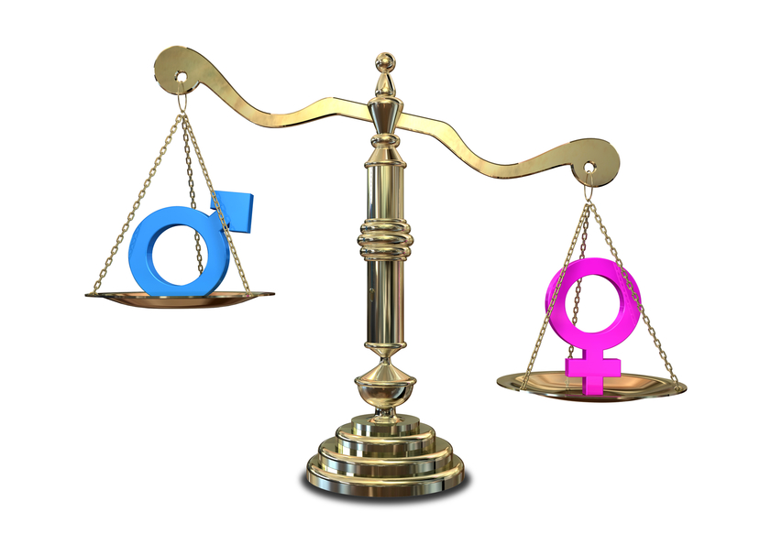
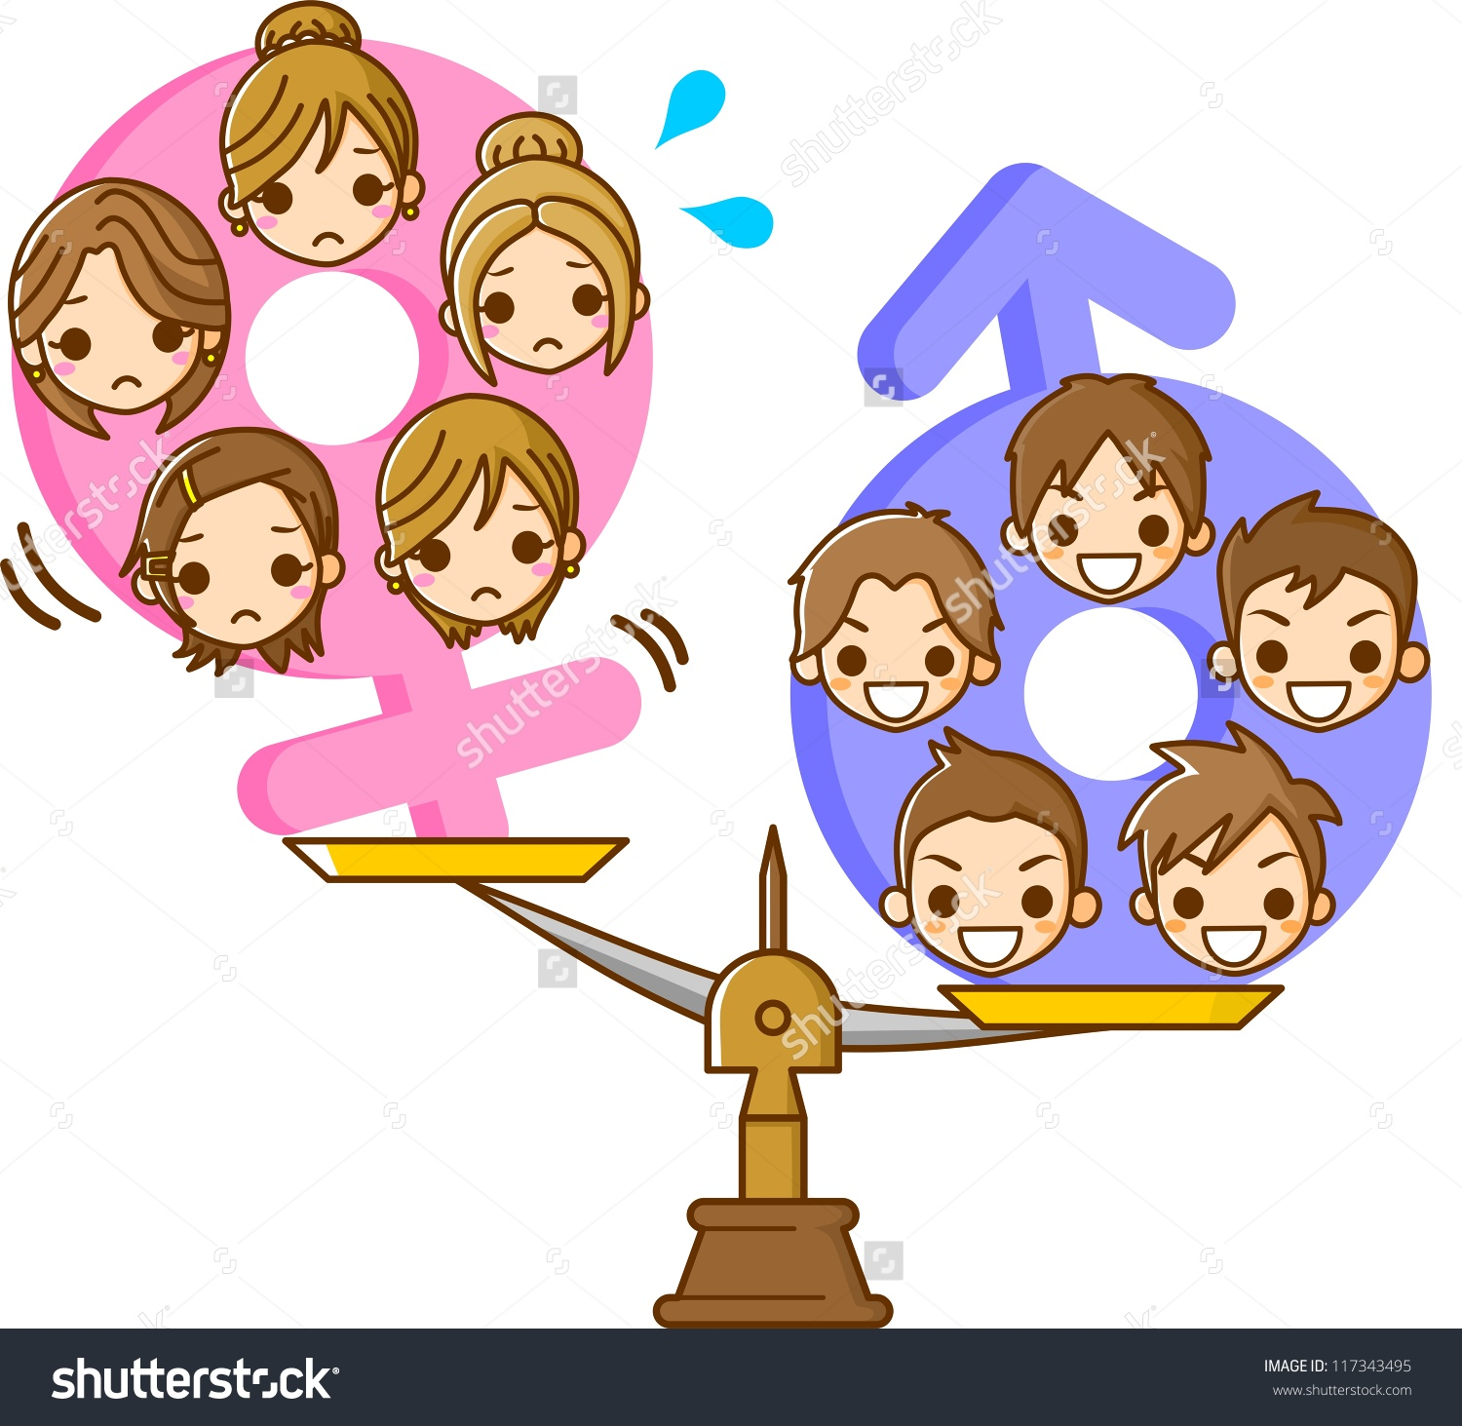
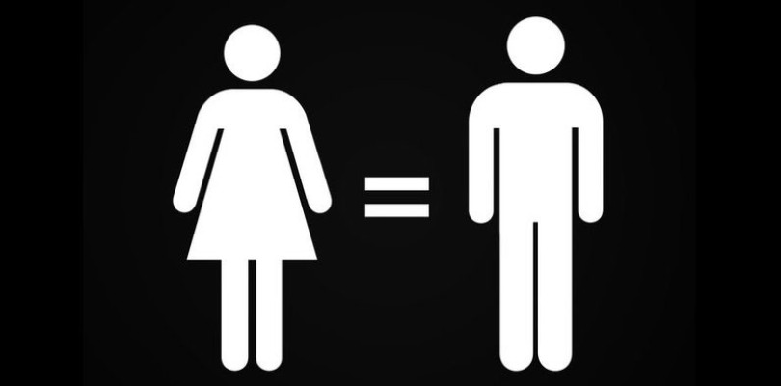
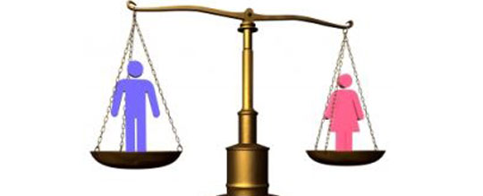
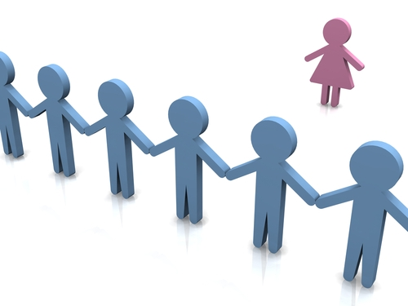
Pictures for Gender Discrimination

Slide 7
Who Helps?
Lots of people help make it fair.Here are some:Susan.B.Anthony,Martin Luther King Jr.,Mahathma Gandhi,Rosa Parks,Sojorner Truth,Ida.B.Wells,Dorthy Height,Patsy Mink,Dolores Huerta,Willma Mankiller and Vannzeta Penn Mcpherson and more.

Slide 8
How we can help
We can help balance the rights.
Woman can speak out to get freedom.
We should respect Woman.

Slide 9
Conclusion
Gender Discrimanation shouldn’t exist.

